Slide 1

ШИНЖЛЭХ УХААН ТЕХНОЛОГИЙН ИХ СУРГУУЛЬ
Мэдээлэл, Холбооны Технологийн Сургууль
F.CS311 Программ хангамжийн бүтээлт
Abstraction, Reuse, and Programming Tools
Лекц 2+
Багш Ганбаатарын ГАНБАТ. Өрөө #304, ganbatg@must.edu.mn, 99999467

Slide 2
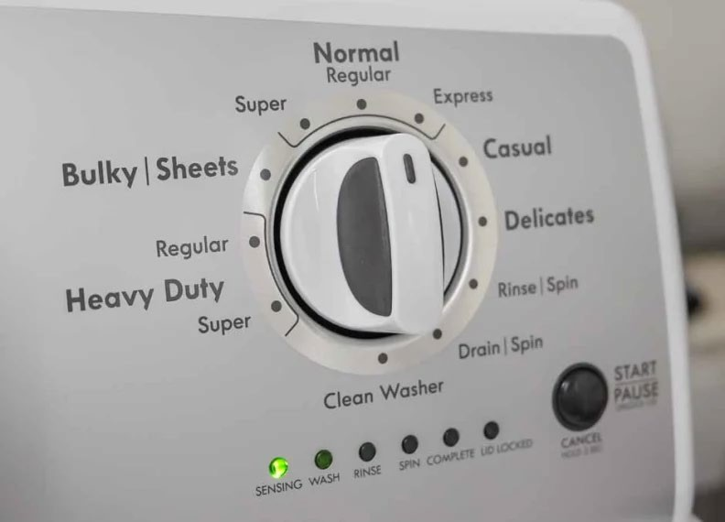
Бүтээмж нь автоматжуулалтыг шаарддаг Автоматжуулалт нь хийсвэрлэл шаарддаг

Slide 3
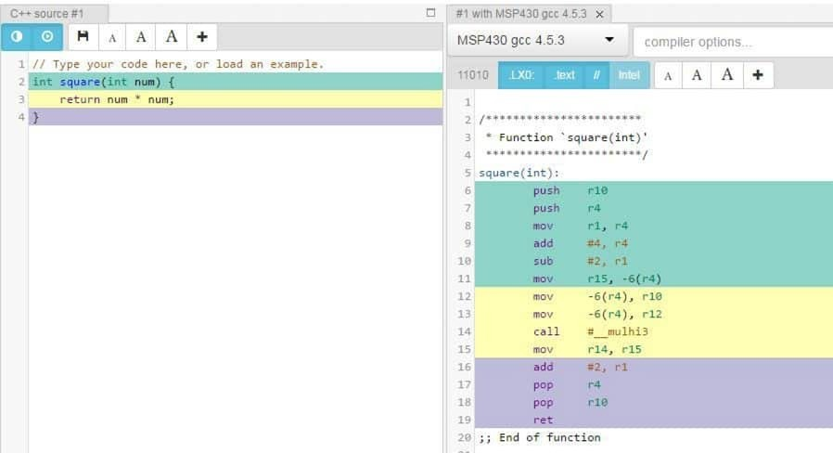

Slide 4
Автоматжуулалт нь хийсвэрлэл шаарддаг
Бид хийсвэрлэлийн харагдаж буй түвшнийг хэвийн гэж үздэг
Зөвхөн юм угаадаг бол ингэж үзэж болно
Цахилгаан хэрэгслийн засварчны хувьд бол тийм биш
Эвдэрсэн угаалгын машиныг хэрхэн шалгах вэ?
Бас удаан хөгждөг
Жнь, нэмэлт найрлагатай угаалгын нунтаг руу шилжих
Хийсвэрлэл нь инженерийн ажлыг хялбарчилж, инженерүүдэд хатуу хэсгүүдэд анхаарлаа төвлөрүүлэх боломжийг олгодог.
Гэхдээ, чадварлаг инженерүүд хийсвэрлэлийн дор юу байдгийг сайн мэддэг

Slide 5
Автоматжуулалт нь хийсвэрлэл шаарддаг
Today’s “normal”:
Integrated-development environments (IDEs)
Web-based too! Press “.” on a GitHub (file) pages
Олон давтагдсан build, test, release
Зарим компаниудад commit бүр нь "release" байдаг.
Хэрэглэхүйц сан байгаа бол кодыг нь бүү бич
“хэрэглэхүйц”?
Дээрх бүгд

Slide 6
Хийсвэрлэл, Дахин ашиглалт, прог-лын хэрэгслүүд
For each in {Build systems, IDE, libraries, CI}:
What is it?
What happens under the hood?
What are some practical ways to use it?
What is next?

Slide 7
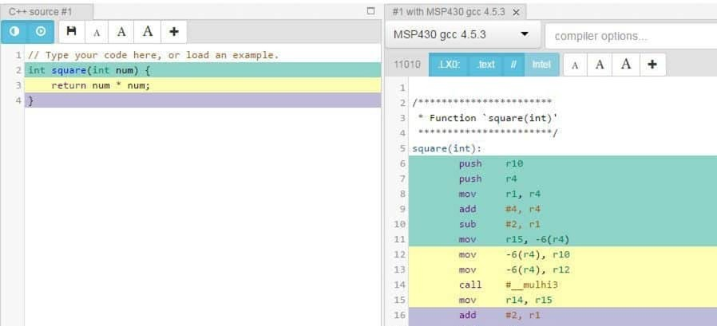
Өнөөдрийн багаж хэрэгслийн товч тойм: Бүтээлтийн систем
Энэ нь яаж болдог вэ?

Slide 8
Программын эхлүүлэх: Жава
Жавагийн бүх код класс дотор байдаг, тэгвэл хэрхэн объектыг хэрхэн үүсгэж, методыг нь дуудах вэ?
Класс дахь main методын тусгай синтакс
// start with: java Printer
in Java, everything is
class
Printer {
void print() {
a class
main метод ажиллан, энд объект үүсгэх, аргыг дуудах зорилгоор ашиглагддаг.
Статик метод нь объект биш класст хамаарах ба ерөнхийдөө тэдгээрээс зайлсхийдэг
System.out.println("hi");
}
public static void ma
in(String[] args)
{
Printer obj = new Printer(); obj.print();
main must be public and
}
}
static

Slide 9
Starting a program: Javascript
This is Typescript code!
Objects do not do anything on their own, they wait for method calls
Every program needs a starting point, or waits for events
// start with: node file.js function createPrinter() {
return {
print: function() { console.log("hi"); }
}
}
const printer = createPrinter(); printer.print()
// hi
Defining interfaces, functions, classes
Starting:
Creating objects and calling methods

Slide 10
SimpleHello.java/SimpleHello.ts
Java:
javac (or your IDE) compiles .java files to .class files
java runs the .class files
Command line execution vs. in VSCode
What’s the -cp doing?

Slide 11
SimpleHello.java/SimpleHello.ts
Java:
javac (or your IDE) compiles .java files to .class files
java runs the .class files
Command line execution vs. in VSCode
-cp gives a path to the classes directory tree
Organized by package just like Java source
-cp also includes .jar files for libraries collected by maven
A .jar file is a zipped up tree of .class files, plus some metadata

Slide 12
SimpleHello.java/SimpleHello.ts
Java:
javac (or your IDE) compiles .java files to .class files
java runs the .class files
Command line execution vs. in VSCode
-cp gives a path to the classes directory tree & .jar files for libraries
TypeScript:
Is transpiled to JavaScript, which is then executed inside a runtime environment.
Outside the browser: we use node.js
Node looks for modules in the node_modules directory
How do modules get there? from npm
npm uses package.json to track modules we depend on & their versions
Why do we encourage you to run everything in an IDE/use Maven/npm?
Hints: what are the roles of -cp in Java? Or node_modules in typescript?

Slide 13
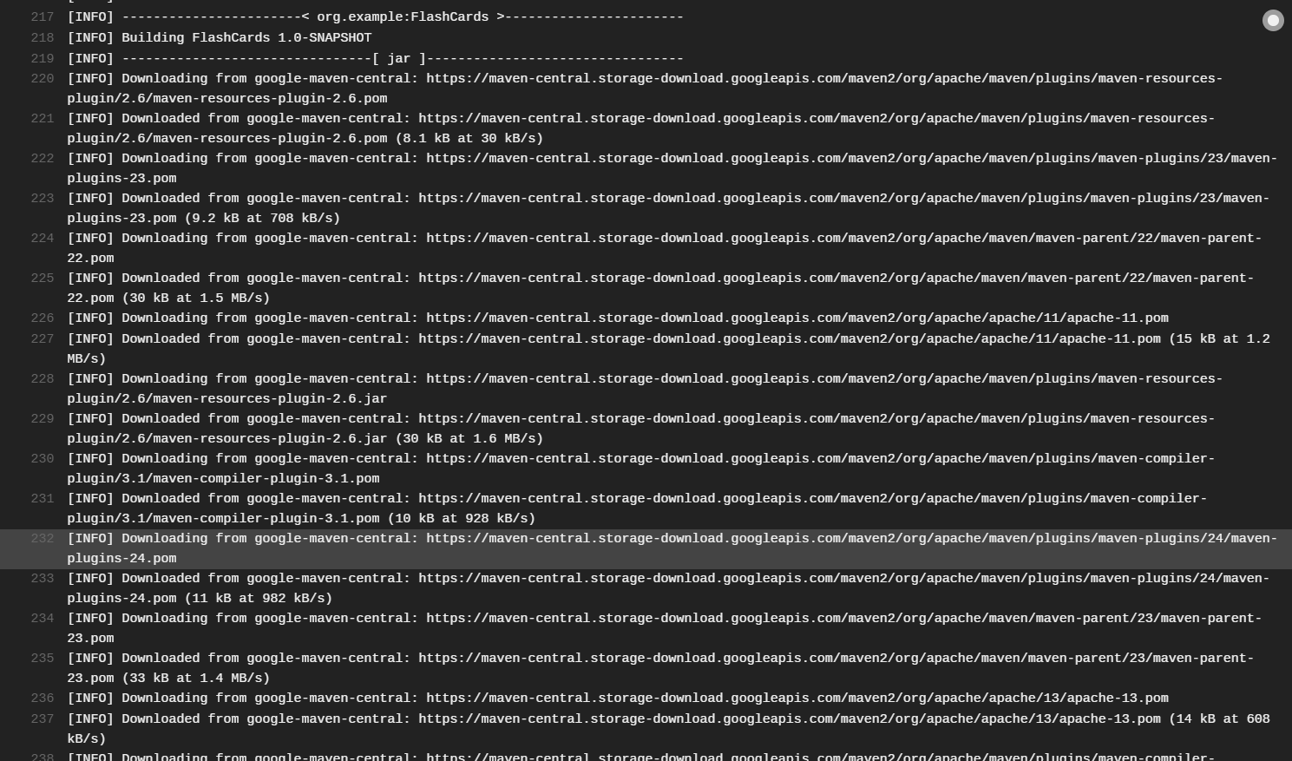
Quick overview of today’s toolchain: Build Systems
Compiling is “easy” when all your
source code is here
Nowadays, your code is not “here”
Even libraries that you use in the IDE!
Interfaces make that possible

Slide 14
Quick overview of today’s toolchain: Build Systems
Building a few basic tasks:
Compiling & linking, to produce an executable
Creating secondary artifacts, e.g. documentation-pages, linter reports, test suite reports
Different levels of “depth” may be appropriate, for large code bases (e.g. Google)
Popular options:
For Java: Maven and Gradle -- historically Ant.
You could do any homework in either, in principle; we just standardize to make helping
you and grading easier.
For JS/TS: Node(JS)
Generally coupled with the Node Package Manager (NPM)
Often built into IDEs, as plugins

Slide 15
Under the Hood: Build Systems
These days: intricately tied with IDEs, package managers
Projects often come with a build config file or two
‘pom.xml’ for Maven
‘tsconfig.json’ + ‘package.json’ for TypeScript+NPM -- the second deals with packages
These can be nested, one per (sub-)directory, to compose larger systems
On GitHub, you can create links across repositories

Slide 16
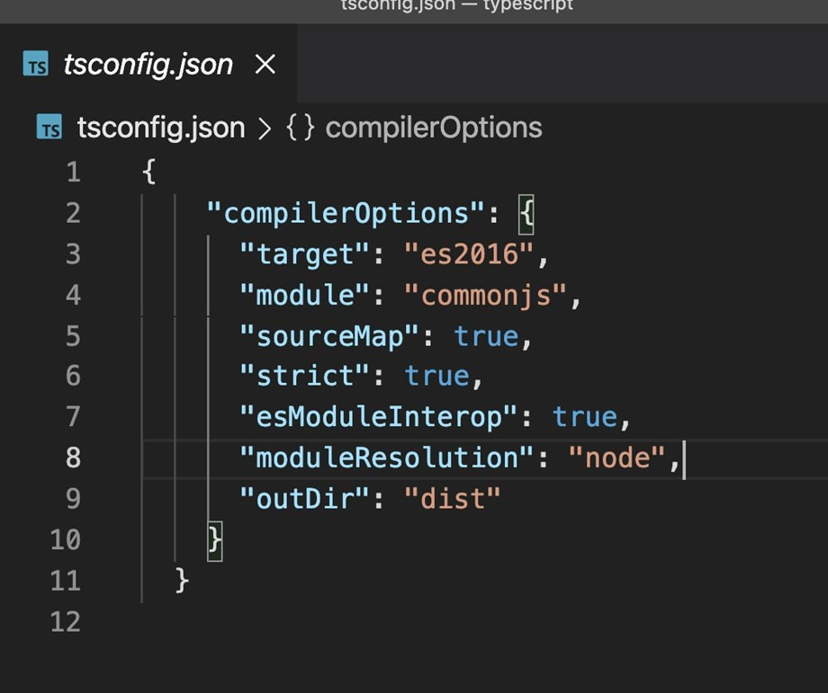
Under the Hood: Build Systems
Projects typically require build config files
Checked into source control
‘pom.xml’ for Maven
‘tsconfig.json’ + ‘package.json’ for TypeScript+NPM -- the second deals with packages
Relevant components:
Compilation source and target version
High-level configuration options
Targets for various development phases
Relevant plugins
Dependencies with versions

Slide 17

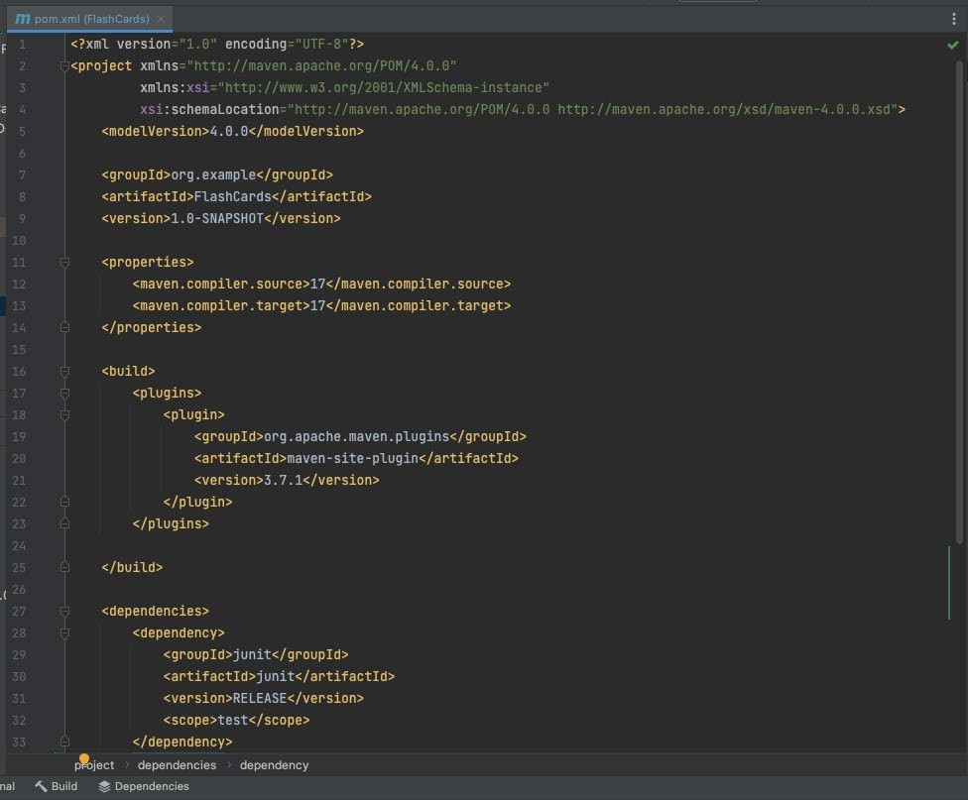
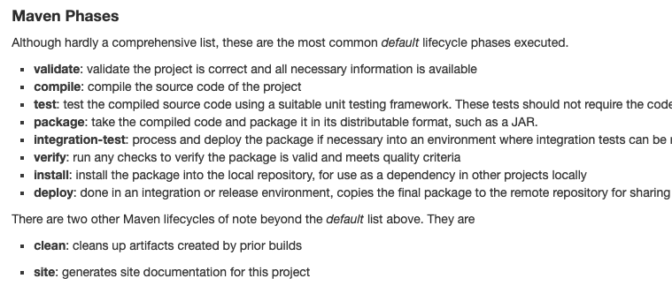
https://maven.apache.org/guides/getting- started/maven-in-five-minutes.html

Slide 18

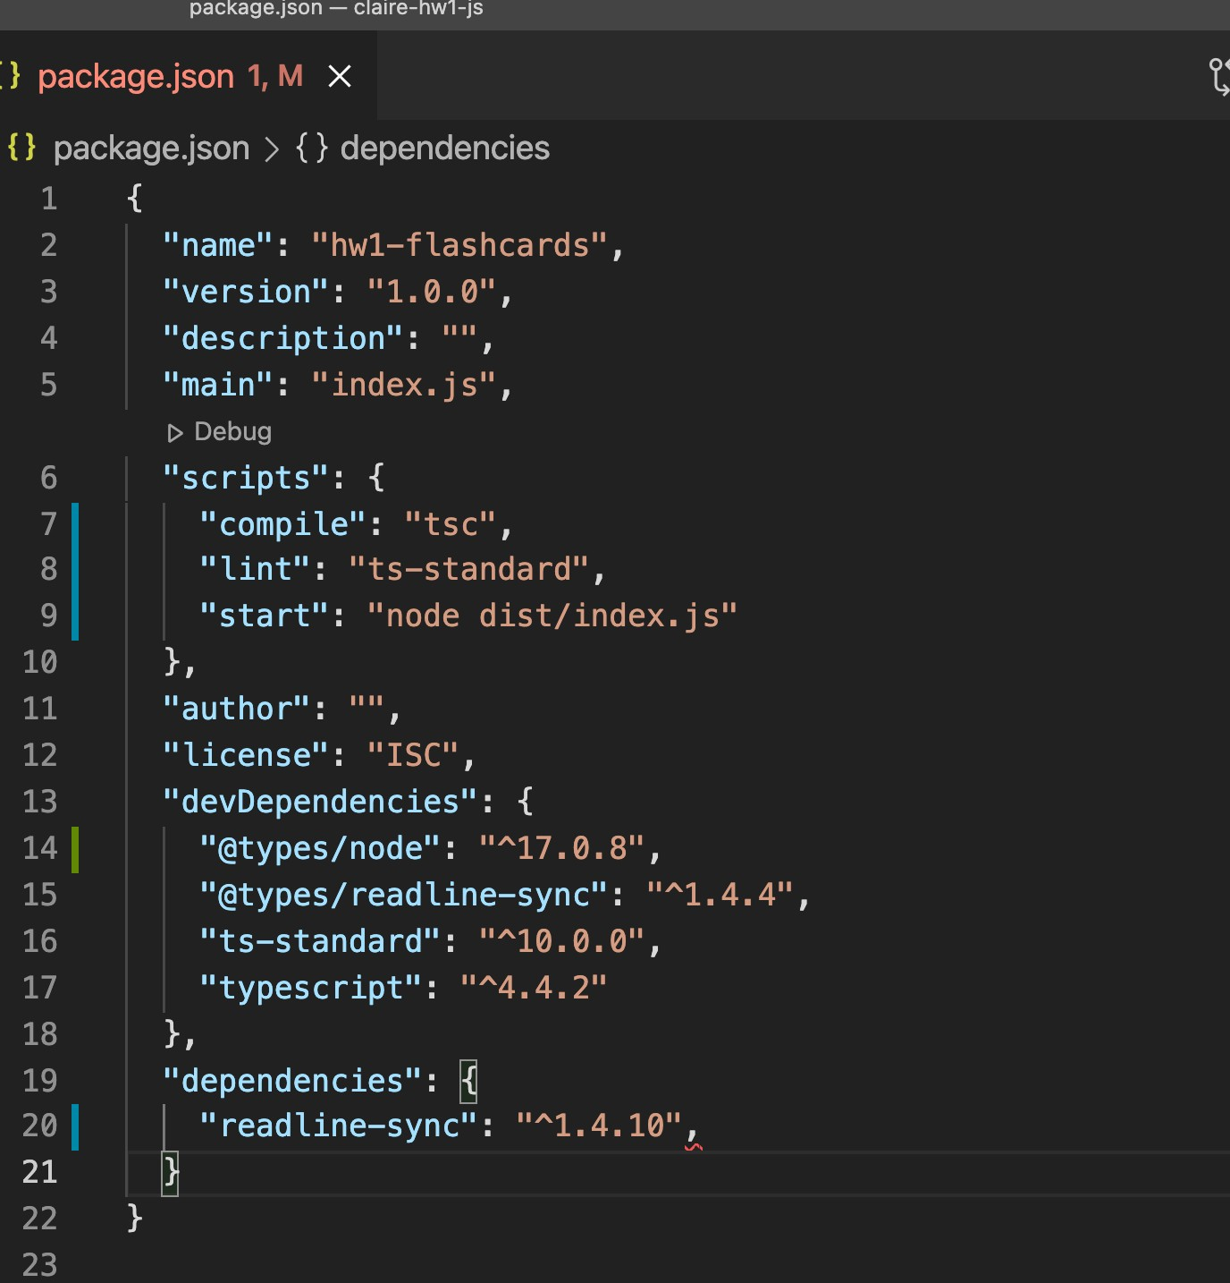
Node.js is a JS runtime. npm is its package manager.

Slide 19
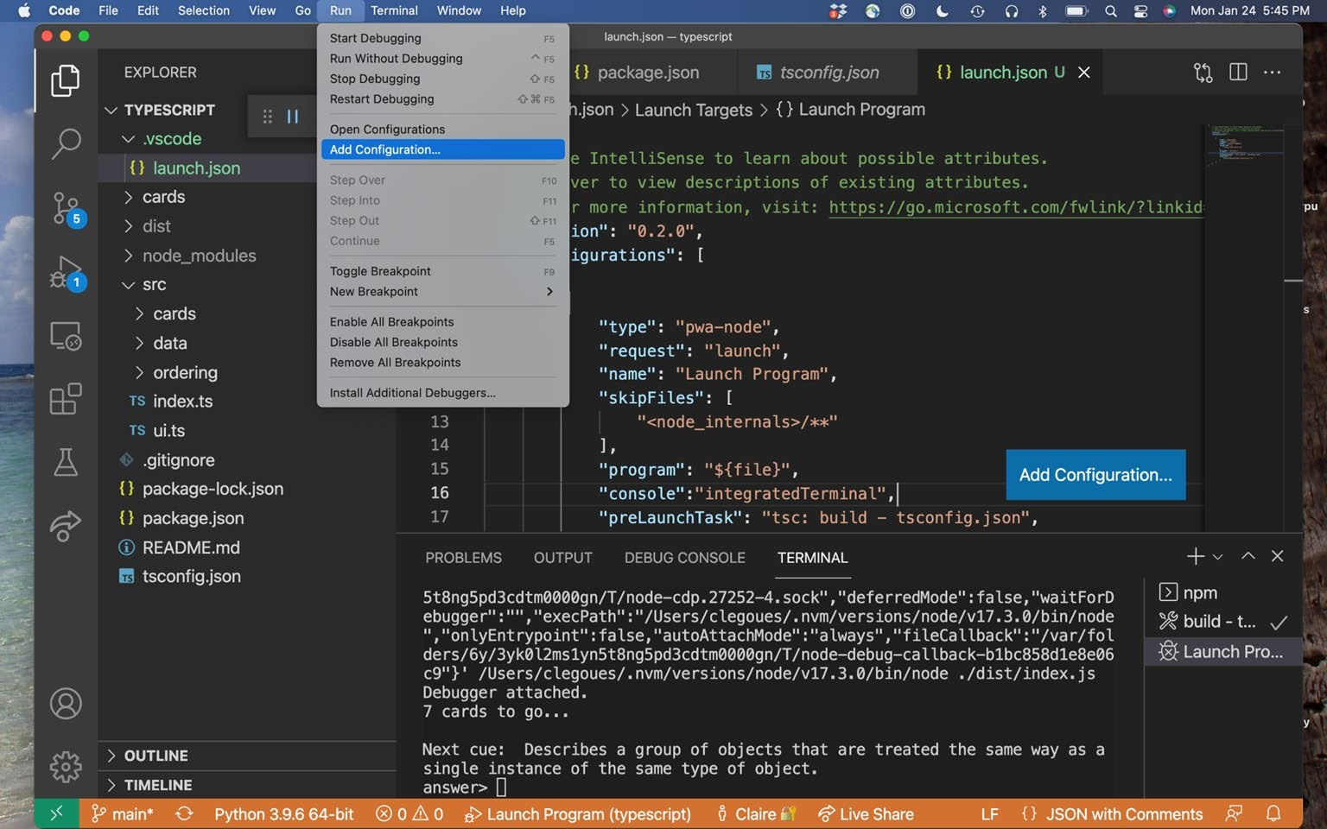
Meanwhile, the IDE can interact with these build systems!

Slide 20
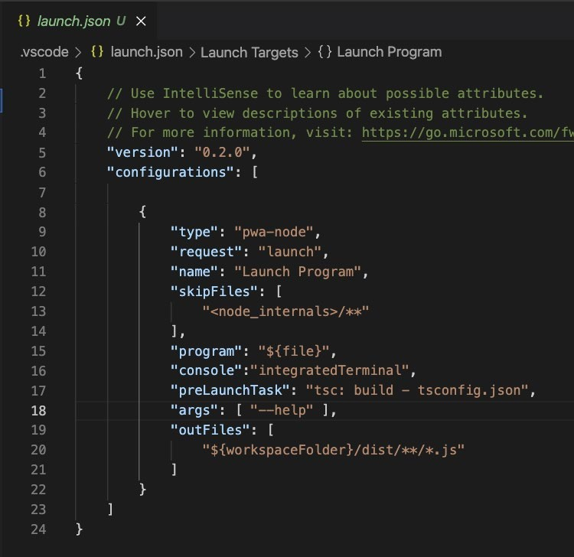
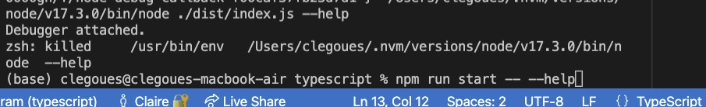

Slide 21
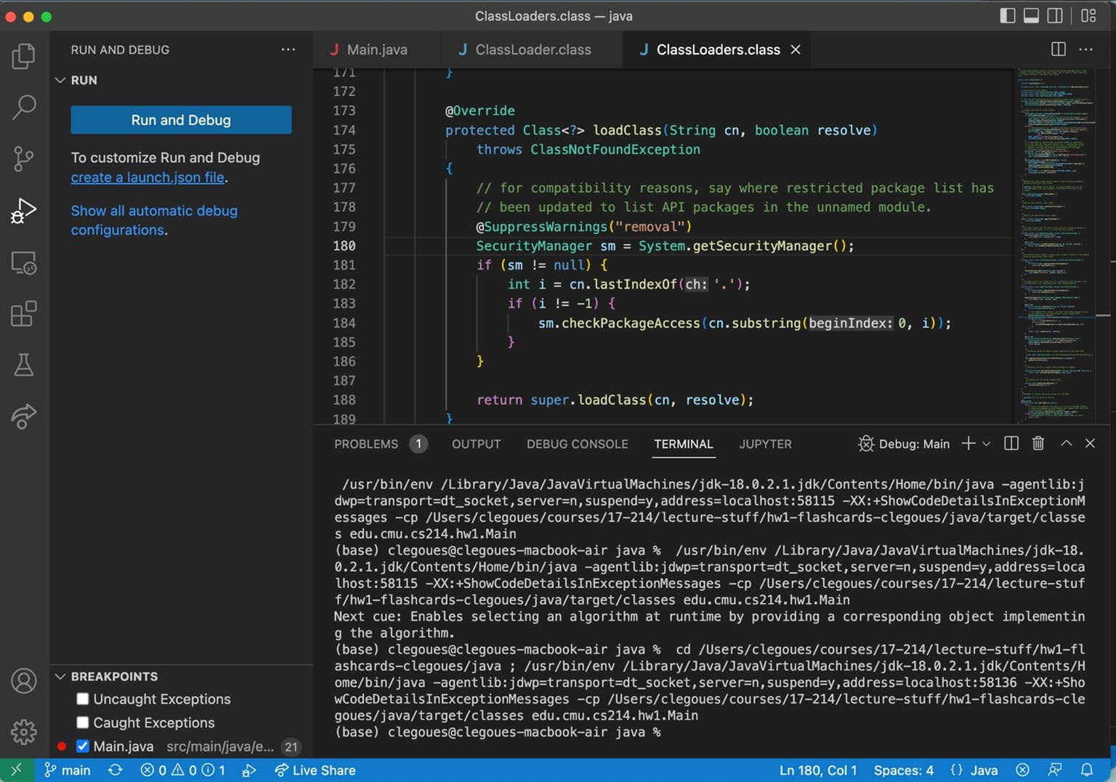

Slide 22
Abstraction, Reuse, and Programming Tools
For each in {Build systems, IDE, libraries, CI}:
What is it?
What happens under the hood?
What are some practical ways to use it?
What is next?

Slide 23
Quick overview of today’s toolchain: IDEs
Integrated Development Environments bundle development workflows in a single UI
Editing, refactoring, running & debugging, adding dependencies, compiling, deploying, plugins, you name it
They often try to be everything, with mixed results
Leverage them to the fullest extent, to automate and check your work
IDEs are key to managing complexity.

Slide 24
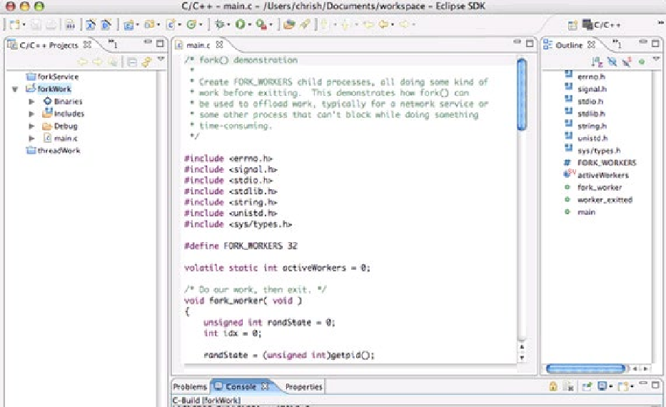
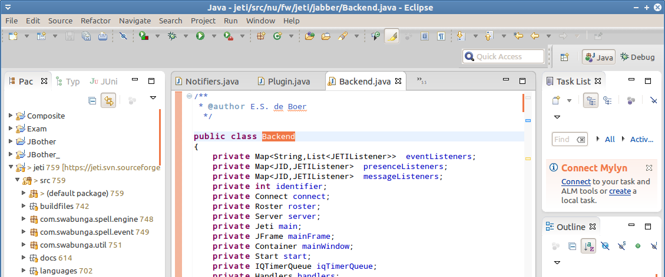
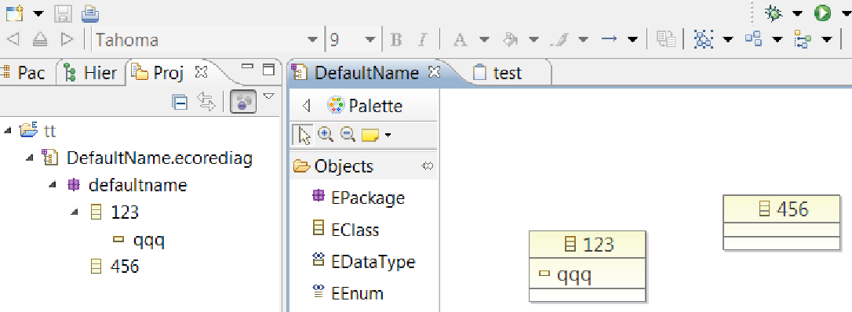
Quick overview of today’s toolchain: IDEs
Eclipse was the dominant player in Java for 20-odd years, owing to its powerful backbone and plugin architecture

Slide 25
Quick overview of today’s toolchain: IDEs
Recently, IntelliJ has been more dominant
Packs a lot of “recipes” to create certain types of projects (e.g., web-app with Spring & Maven)
VSCode is surging in popularity
Local & web, lightweight but with a massive plugin ecosystem
In general: choose based on need!
You can relearn key-bindings; “killer features” are rare and temporary
E.g., Android: might want Android Studio (itself built on IntelliJ) since Google supports it
We recommended VSCode because you’re programming in two languages, it’s very current, and
then it’s easier for us to help you.

Slide 26
Under the Hood: IDEs
The engine: continuous parsing, building
Key feature: most partial programs don’t parse, but IDEs make sense of them
That allows quickly relaying compile warnings/errors and useful suggestions
Same with API resolution
Powered by rapid incremental compilation
Only build what has been updated
Virtually every edit you make triggers a compilation, re-linking
Of just the changed code and its dependencies
Works because very little of the code changes most of the time
But no free lunch: tends to drop optimizations (mostly fine), may struggle with big projects
Just try it: call an API with the wrong parameters & see how fast it triggers an alert; contrast
with running a full Maven build (e.g., with `mvn install`)

Slide 27
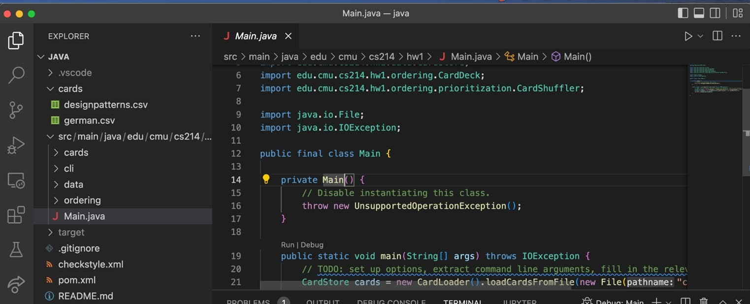

Under the Hood: IDEs
Automate common programming actions, like debugging, which is often the default mode when you run in the IDE (like in VSCode)

Slide 28
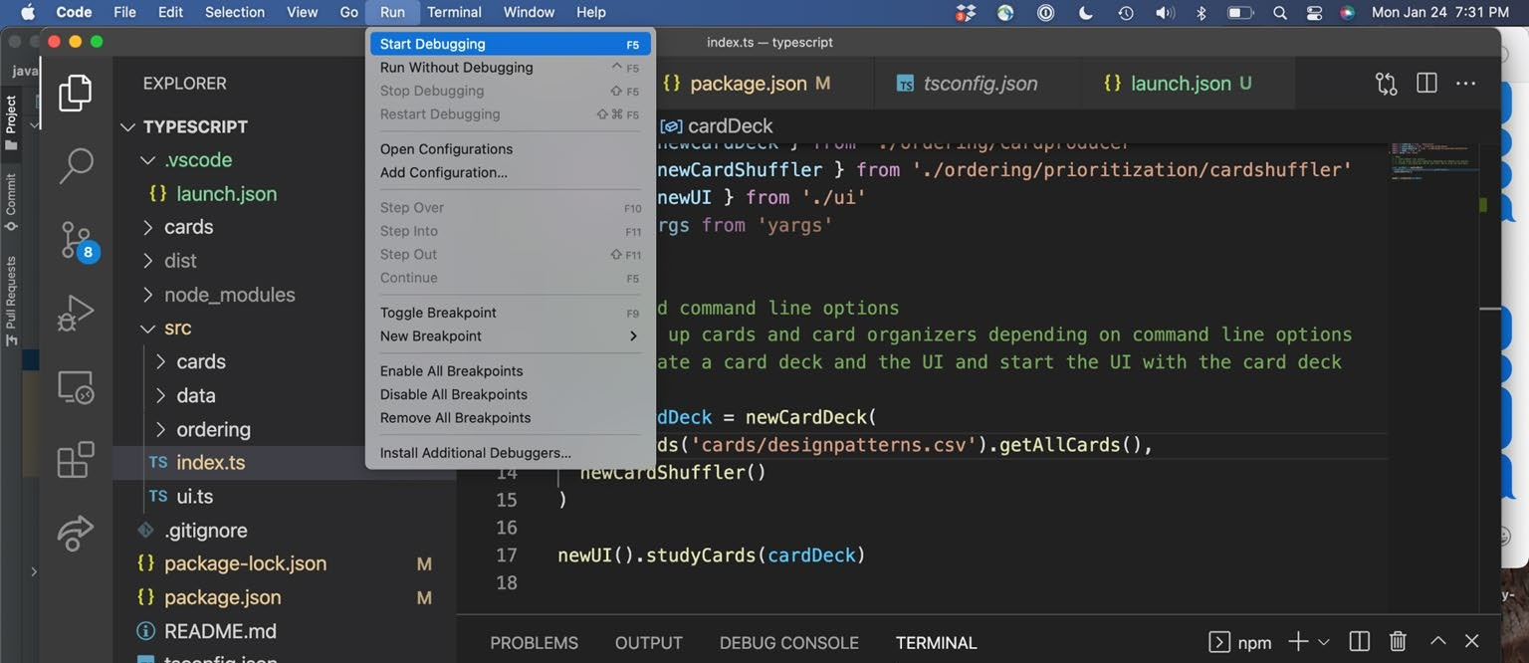

Under the Hood: IDEs
Debugging allows setting breakpoints in the GUI, access to rich execution info.
TS:

Slide 29
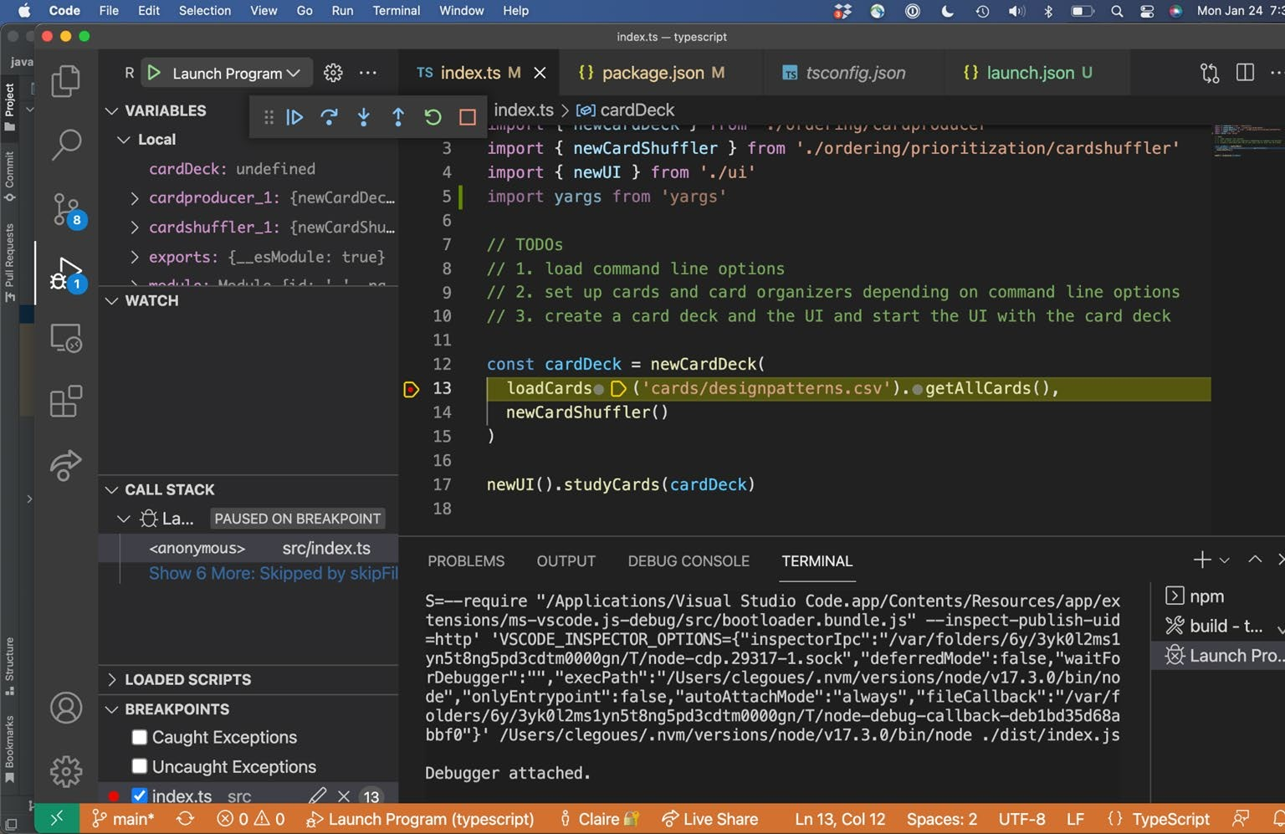

Slide 30
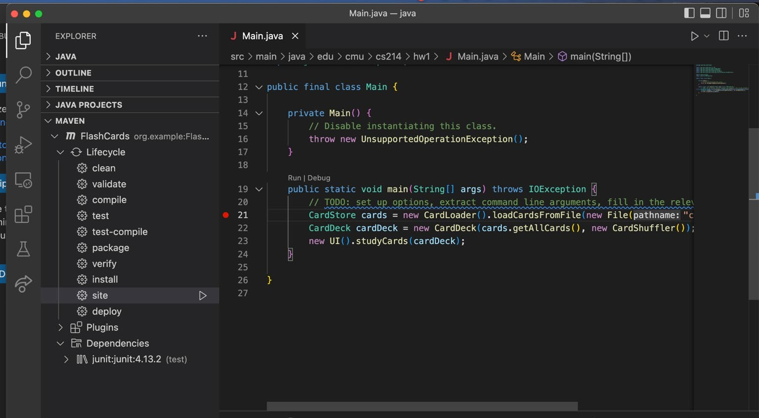
Under the Hood: IDEs
Combine build systems + IDEs + plugins (checkstyle example/demo!)

Slide 31
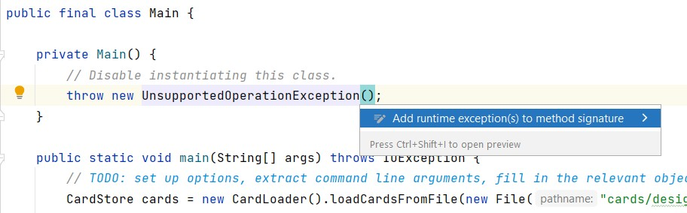
Under the Hood: IDEs
Automate common programming actions:
Handy refactorings, suggestions
E.g., just press `alt+enter` in IntelliJ while highlighting nearly any code
Keyboard shortcuts are super useful: explore your IDE!
These can make you a better programmer: encode a lot of best-practices
Though, don’t read into them too much

Slide 32
Under the Hood: IDEs
IDE designers spend a lot of time automating common development tasks
Sometimes they get a little too helpful (modifying pom’s)
Many plugins provide customized experience
Mostly evolve with new tools, prioritizing emerging routines
Useful to know how these actions work
Often not much more than invoking commands for you
VSCode is very explicit about this in the terminal -- great for customization

Slide 33
Abstraction, Reuse, and Programming Tools
For each in {Build systems, IDE, libraries, CI}:
What is it?
What happens under the hood?
What are some practical ways to use it?
What is next?

Slide 34
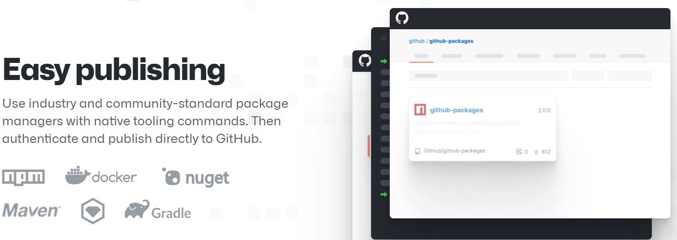
Quick overview of today’s toolchain: Libraries
Reusable packages of code.
Publicly hosted on various package managers
Often tied, but not inextricably linked, to build tools, and languages
Maven/Gradle for Java, NPM for JS/TS, Nuget for C#, ...
Cross-language package registries, e.g., GitHub Packages

Slide 35
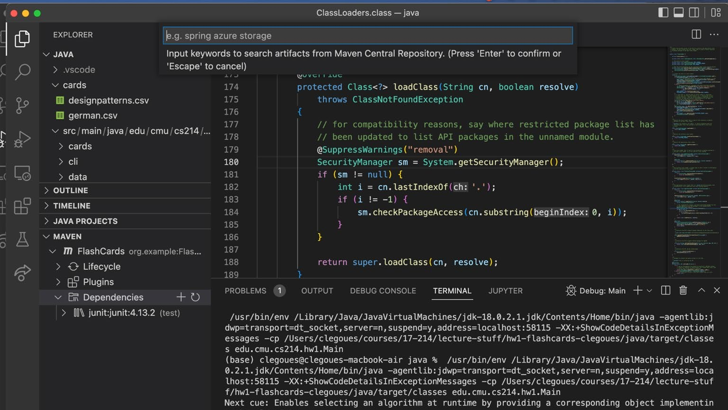
Java:

Slide 36
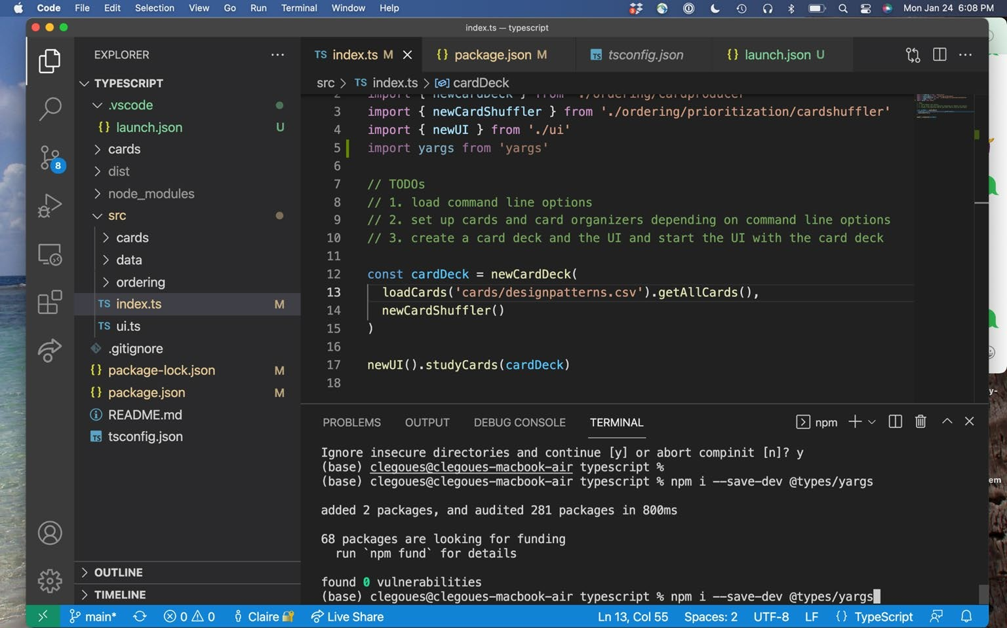

Slide 37
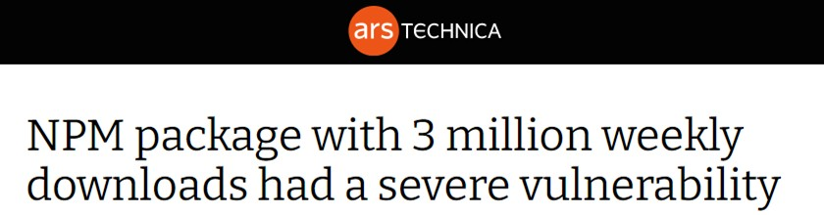
Quick overview of today’s toolchain: Libraries
Myriad. Publicly hosted on various managers
Often tied, but not inextricably linked, to build tools, and languages
Maven, Gradle, NPM, Nuget, Docker, …
Cross-language package registries, e.g., GitHub Packages
Releases are generally fast-paced or frigid
Almost all volunteer-based, so support waivers, as does documentation quality
Often open-source, so you can check out the status & details on GitHub
Beware of vulnerabilities and bugs, esp. with minor-releases and nightly’s, old packages

Slide 38
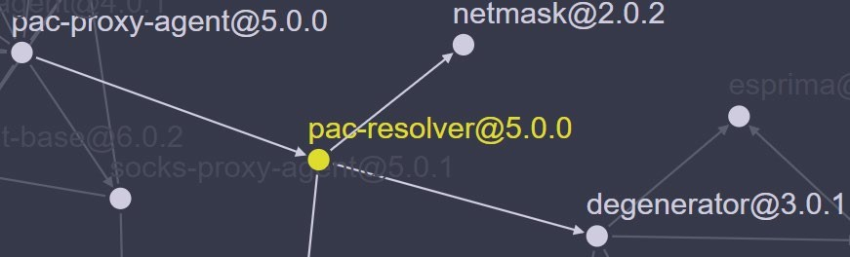
Quick overview of today’s toolchain: Libraries
A Case-Study:
‘pac-resolver’ (3M weekly downloads) has a major security vulnerability
Uses ‘degenerator’ (same author), which misuses a Node module
“The vm module is not a security mechanism. Do not use it to run untrusted code.”
(a mistake that’s been made before: people rarely read disclaimers)
‘pac-proxy-agent’ (2M weekly downloads, same author) uses the above
Is widely popular, the main reason people use ‘degenerator’
Most people using this package have never heard of the latter -- many never will

Slide 39
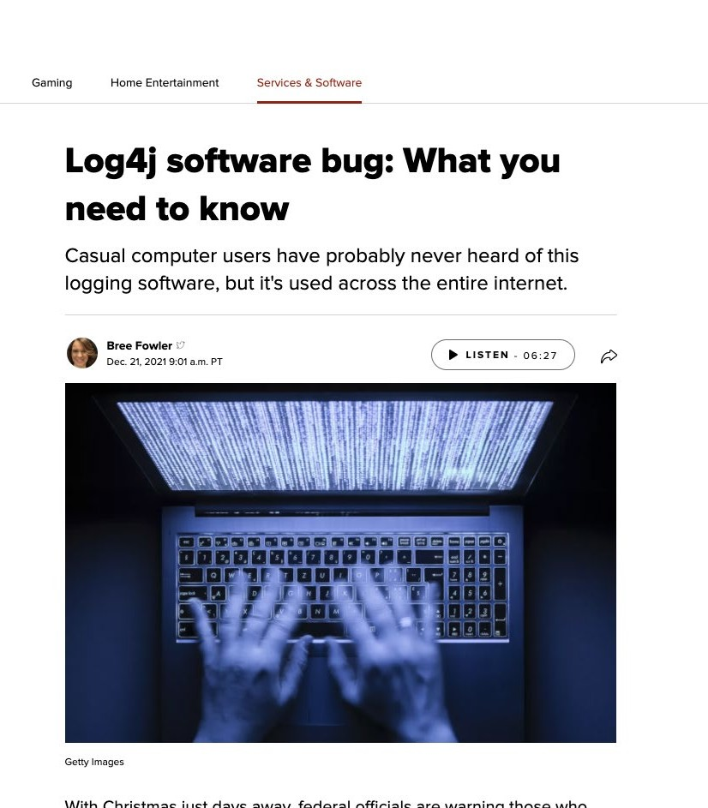
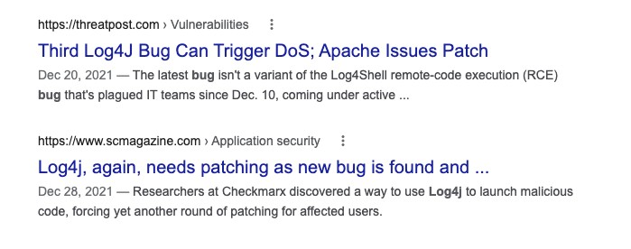
log4shell

Slide 40
Under the Hood: Libraries & Frameworks
Packages can be either:
Libraries:
A set of classes and methods that provide reusable functionality
Typically: programmer calls, library returns data, that’s it.

Slide 41
Under the Hood: Libraries & Frameworks
Packages can be either:
Libraries:
A set of classes and methods that provide reusable functionality
Typically: programmer calls, library returns data, that’s it.
Frameworks:
Reusable skeleton code that can be customized into an application
Framework calls back into client code
The Hollywood principle: “Don’t call us. We’ll call you.”
E.g., GUI development: you declare your UI elements, how they drawn; framework invokes them
Principle: inversion of control

Slide 42
Under the Hood: Libraries & Frameworks
Packages can be either:
Libraries:
A set of classes and methods that provide reusable functionality
Typically: programmer calls, library returns data, that’s it.
Frameworks:
Reusable skeleton code that can be customized into an application
Framework calls back into client code
The Hollywood principle: “Don’t call us. We’ll call you.”
E.g., GUI development: you declare your UI elements, how they drawn; framework invokes them
Principle: inversion of control
You typically use zero/one framework and many libraries
Frameworks might be especially constraining, but in exchange you can reuse more functionality
Some tools are a bit of both, and not all frameworks quite invert control

Slide 43
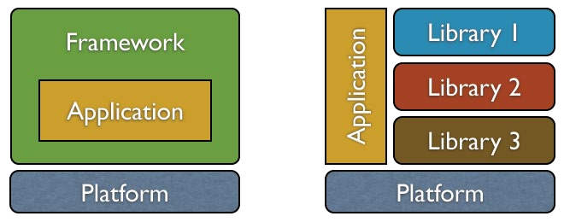
Under the Hood: Libraries & Frameworks
Which kind is a command-line parsing package?
Which kind is Android?
How about a tool that runs tests based on annotations you add in your code?
http://tom.lokhorst.eu/2010/09/why-libraries-are-better-than-frameworks`

Slide 44
Under the Hood: Libraries & Frameworks
Look into:
Stated Goal:
A simple interface (“get started in one line!”) also means lots of abstraction
That’s neither good nor bad; know what you need
Docs with “advanced use cases” are always neat
Maintenance:
Active release cycle, recent updates to documentation
GitHub build status, issue tracker (filled with unmerged ‘dependabot’ PRs?)
Lots of companies deliberately lag by one minor (or even major) version
Transitive dependencies
Myriad, beyond inspection. Using OSS in corporate environments is a headache

Slide 45
Abstraction, Reuse, and Programming Tools
For each in {Build systems, IDE, libraries, CI}:
What is it?
What happens under the hood?
What are some practical ways to use it?
What is next?

Slide 46
Quick overview of today’s toolchain: Continuous Integration
CI: Automates standard build, test, deploy pipelines
(Technically, the latter is “CD”)
Typically builds from scratch in a clean container
Often tied to code-review; triggers on new commits, pull requests
Ideally, official releases pass the build Produces (long) logs with debugging outputs

Slide 47
Under the Hood: Continuous Integration
Defines a series of actions to be run in a clean build:
Actions start from the very top:
Clone repository, checkout branch
Download & install Java/Node
Invoke commands with timeouts
Travis allocates a new (Docker) container for each build
Think of this like a fresh, temporary computer
Usually with a few default libraries present (i.e., based on an image)
That means: fully replicable builds

Slide 48
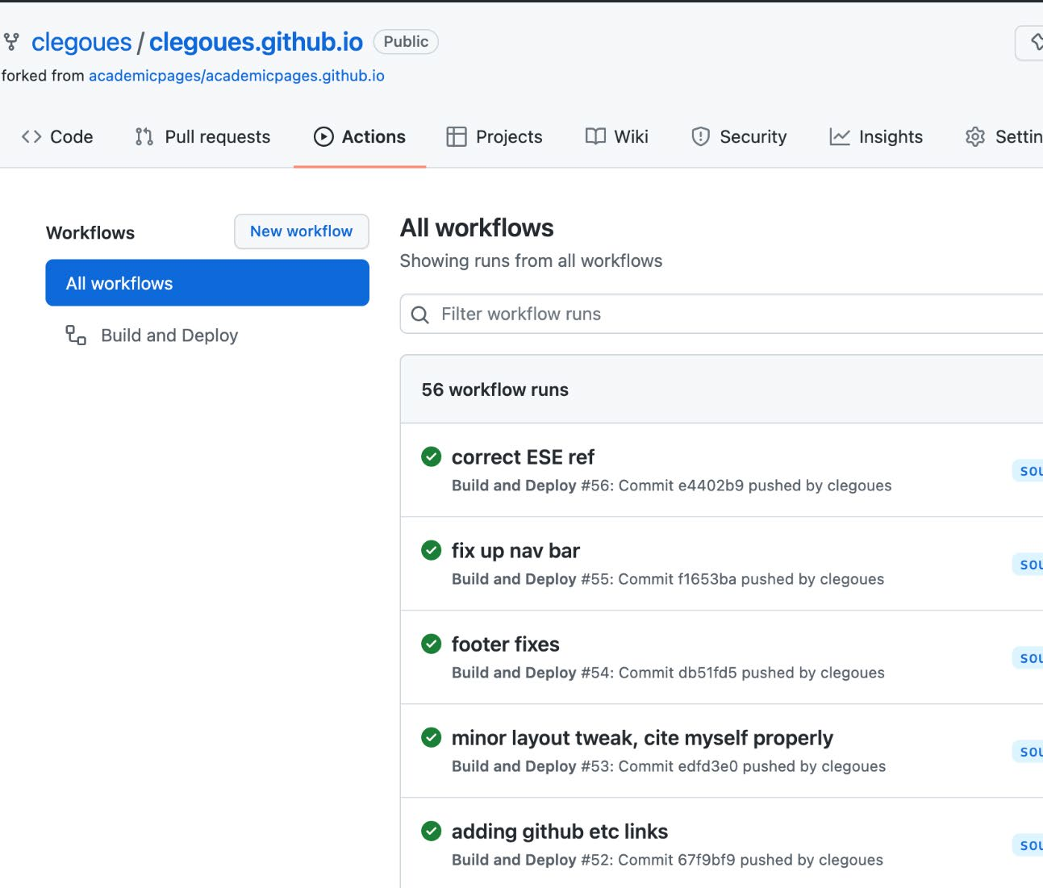
Continuous integration – GitHub Actions
You can see the results of builds over time

Slide 49
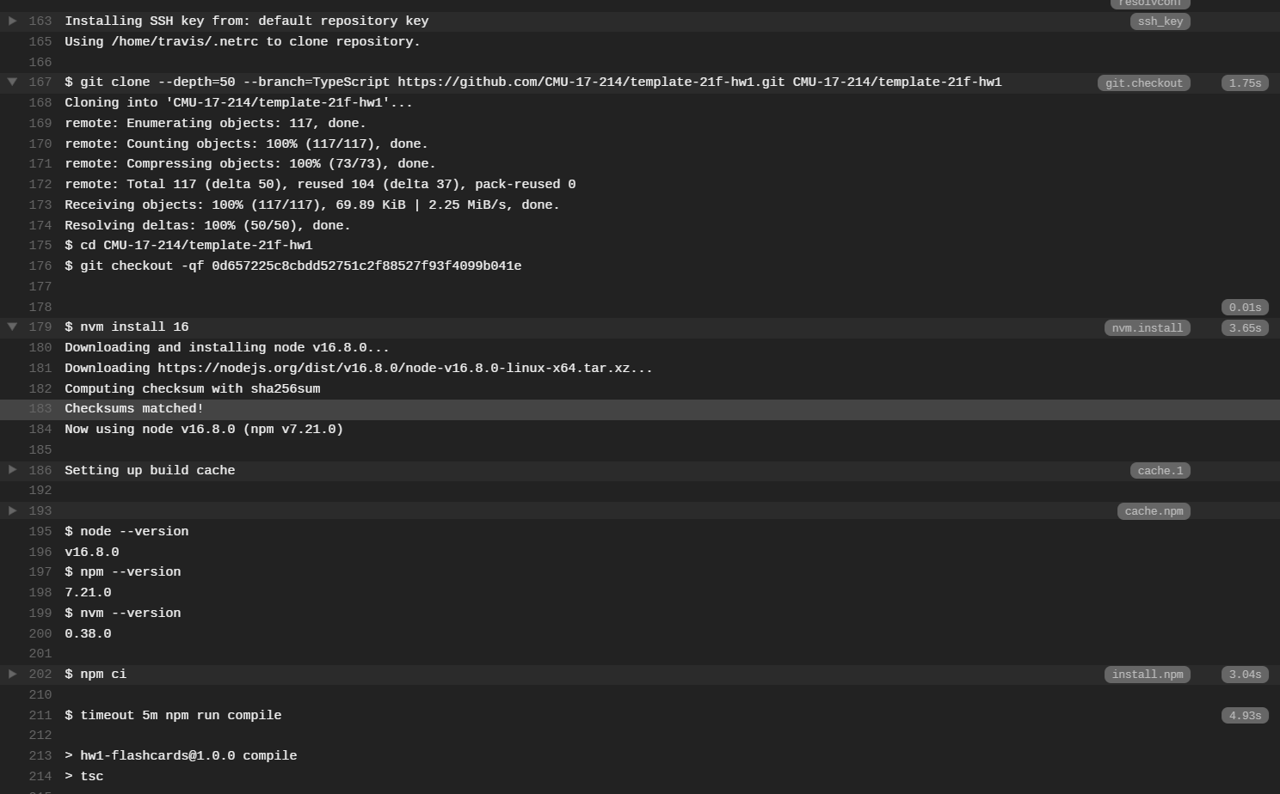

Slide 50
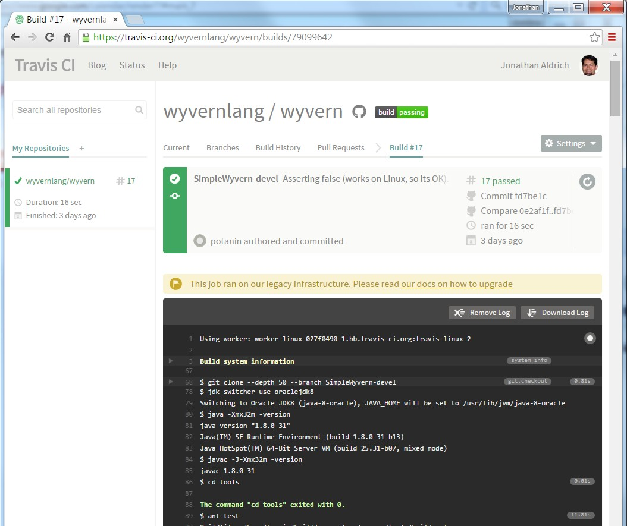
Under the Hood: Continuous Integration
Automatically builds, tests, and displays the result
We – and everyone else – used to
use Travis CI.
Until they randomly stopped
supporting OSS.
GitHub has native CI support, and it’s pretty good: GitHub Actions.
Sidebar on how our GH Actions
are configured for HW1

Slide 51
Quick overview of today’s toolchain: not mentioned
Docker: containerize applications for coarse-grained reuse
Cloud: deploy and scale rapidly, release seamlessly Bug/Issue trackers, often integrated with reviews

Slide 52
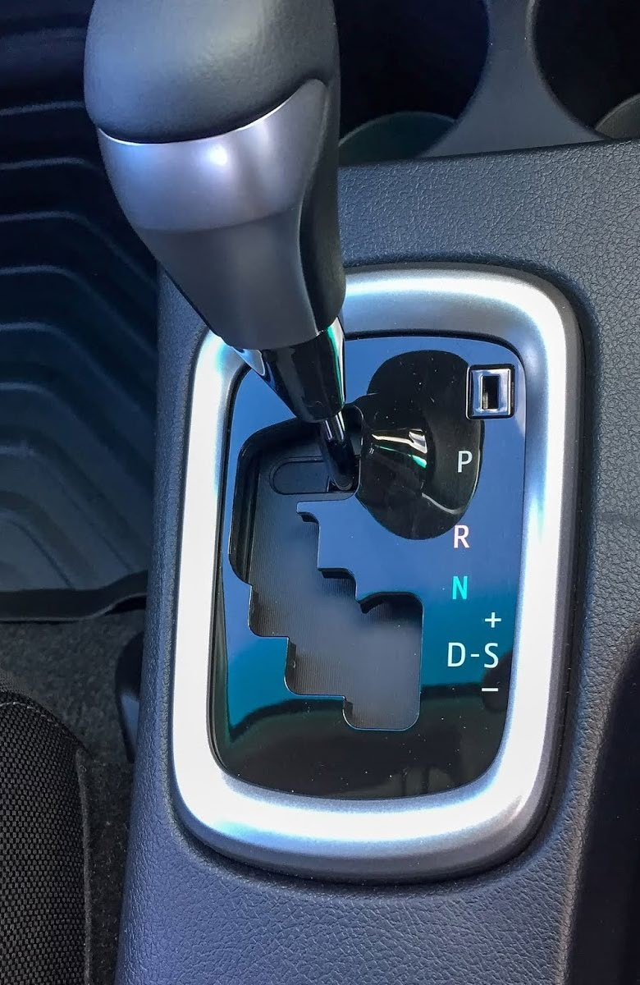
Behind the Abstraction: Some Nuance
Automation vs. Reuse
We tend to automate common chains of actions
Gear-up := {Press clutch, switch gear, release clutch while accelerating}
To facilitate reusing such “subroutines”, we introduce abstractions
Accelerate in ‘D’ => Gear-up when needed
Reuse vs. Interfaces
Interfaces facilitate reuse through abstraction
Allow upgrading implementation without breaking things
Provide explicit & transparent contract

Slide 53
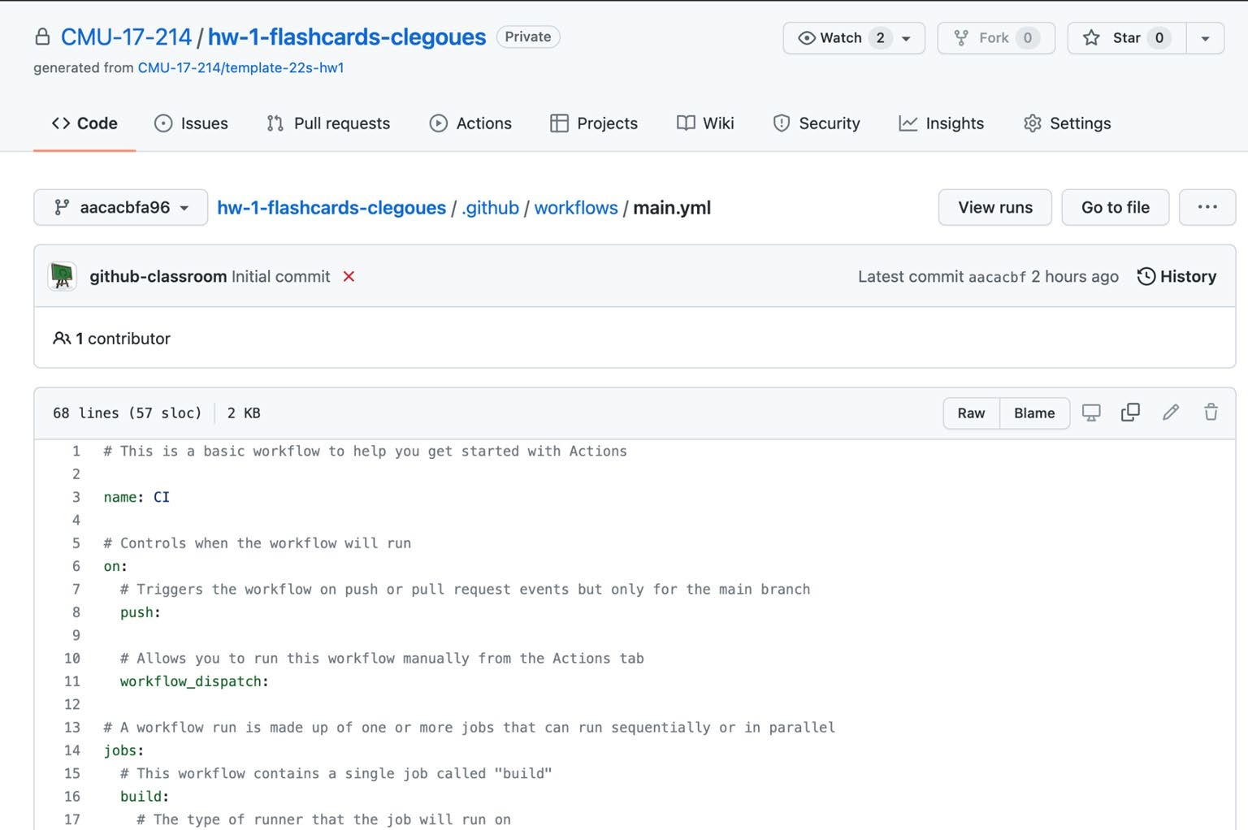
Behind the Abstraction, Some Nuance
Most tools are abstractions of common commands
Typically operated via
GUI and/or a DSL
Obvious for GitHub Actions: just read the Yaml
Script-like languages are common
Involving a vocabulary
of “targets”
E.g., `mvn site`

Slide 54
Behind the Abstraction, Some Nuance
Most tools are abstractions of common commands
Typically operated via GUI and/or a DSL
Obvious for GitHub Actions: just read the Yaml
Script-like languages are common
Involving a vocabulary of “targets”
E.g., `mvn site`
Abstraction can also “trap” us
When/how do we leave the abstraction?
Command-line comes built into IDEs for a reason
Non-trivial in general! May require switching/“patching” libraries
E.g., Maven → Gradle for more unusual build routines

Slide 55
Abstraction, Reuse, and Programming Tools
For each in {Build systems, IDE, libraries, CI}:
What is it?
What happens under the hood?
What are some practical ways to use it?
What is next?

Slide 56
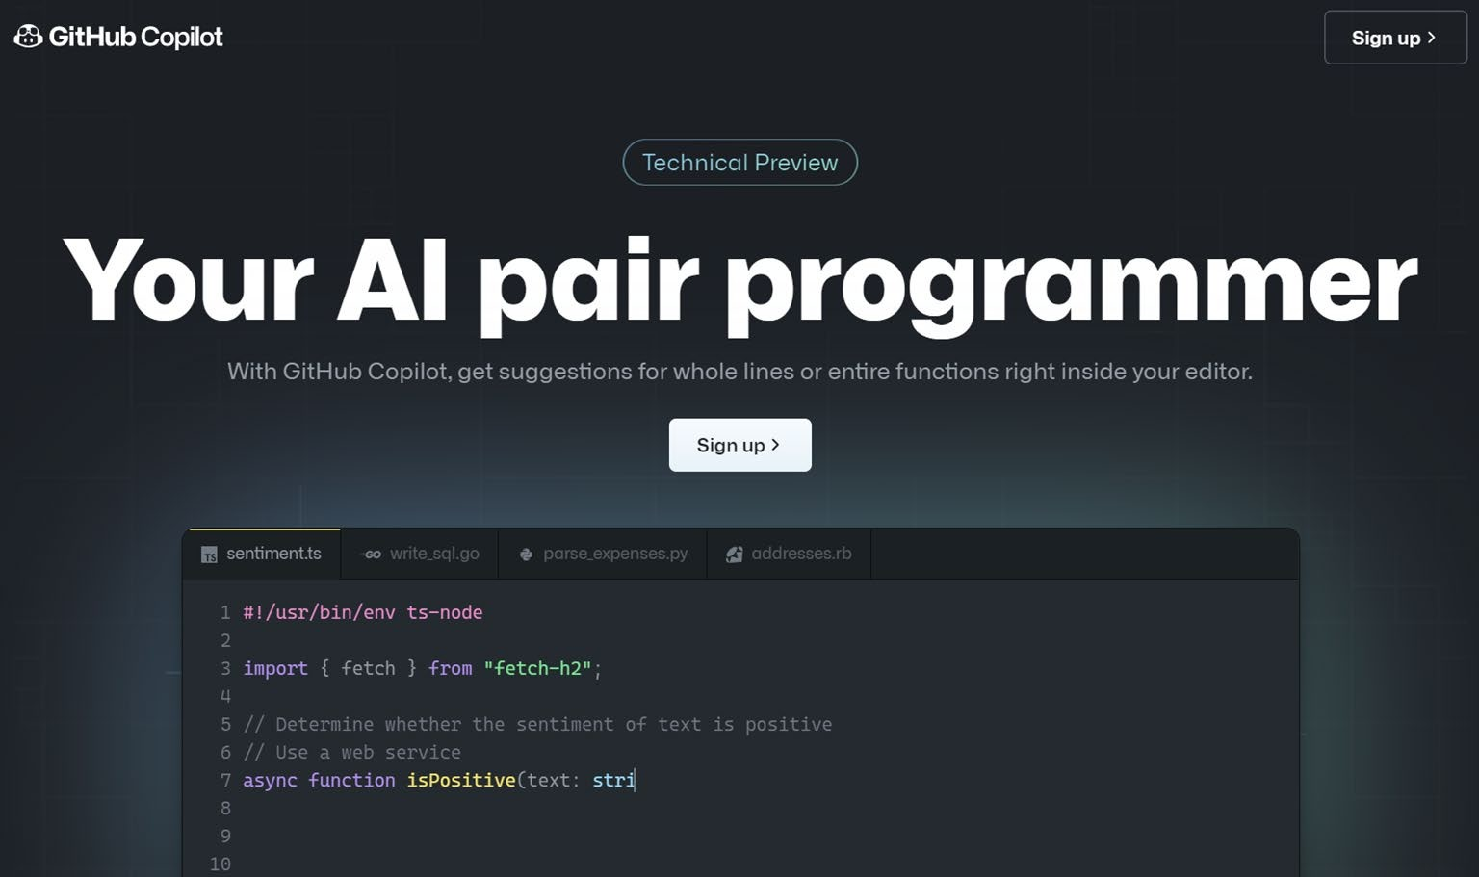
What’s Next: AI Powered Programming
Easier in Web IDEs
Which are themselves
“next”

Slide 57
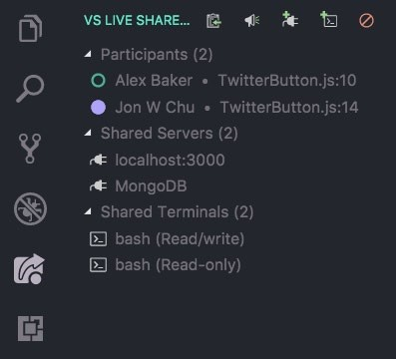
What’s Next: Collaborative online coding
Think: Google Docs for code
E.g. VS Live Share
How will this change “commits”?

Slide 58
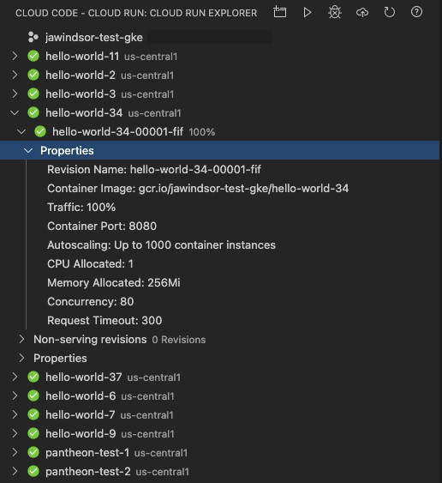
What’s Next: Tighter IDE-to-cloud integration
Google Cloud is pushing on this
with VSCode
We will (lightly) touch on Containers & Clouds in this course

Slide 59
Summary
Programming Tools are abundant, and rapidly evolving
Learn multiple; you will have to inevitably
They rely on abstractions through interfaces to facilitate reuse
Which come in many shapes: GUI, API, DSL
And can be a limitation -- choose wisely

